Slide 1
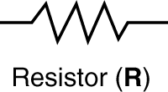

ELECTRICAL SYSTEM MODELING: RESISTORS
Voltage across resistors is proportional to the current passing through it. The constant of proportionality is known as Resistance.
For a wire of length L, cross-sectional area A and resistivity $ρ$:
$R=ρL/A$

Slide 2
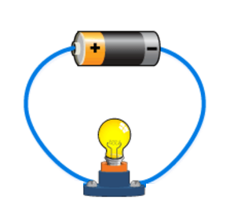
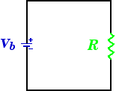

ELECTRICAL SYSTEM MODELING: RESISTORS
Basic electrical circuits are analogous to hydraulic systems/Water flow analogy
Ohm’s law governs the relationship between current, resistance and voltage
$$V=I∗R$$
http://alpcentauri.info/waterflowanalogy.html

Slide 3
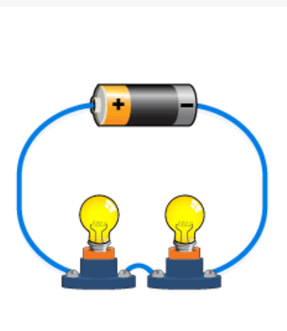
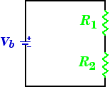

ELECTRICAL SYSTEM MODELING: RESISTORS IN SERIES/PARALLEL
Resistors connected in series have the same current.
$$R_{Total}=R_{1}+R_{2}$$
http://www.instructables.com/id/Operation-Game/step16/About-Parallel-and-Series-Circuits/
http://alpcentauri.info/waterflowanalogy.html

Slide 4
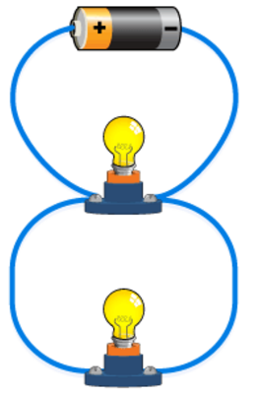
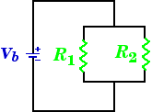

ELECTRICAL SYSTEM MODELING: RESISTORS IN SERIES/PARALLEL
Resistors connected in parallel have the same potential but different current values.
Adding more resistors to a parallel circuit results of having less overall resistance.
Since there are multiple pathways by which charge can flow, adding another resistor in a separate branch adds additional pathway for the charges.
$$\frac{1}{R_{Total}}=\frac{1}{R_{1}}+\frac{1}{R_{2}}$$
http://www.instructables.com/id/Operation-Game/step16/About-Parallel-and-Series-Circuits/
http://alpcentauri.info/waterflowanalogy.html

Slide 5

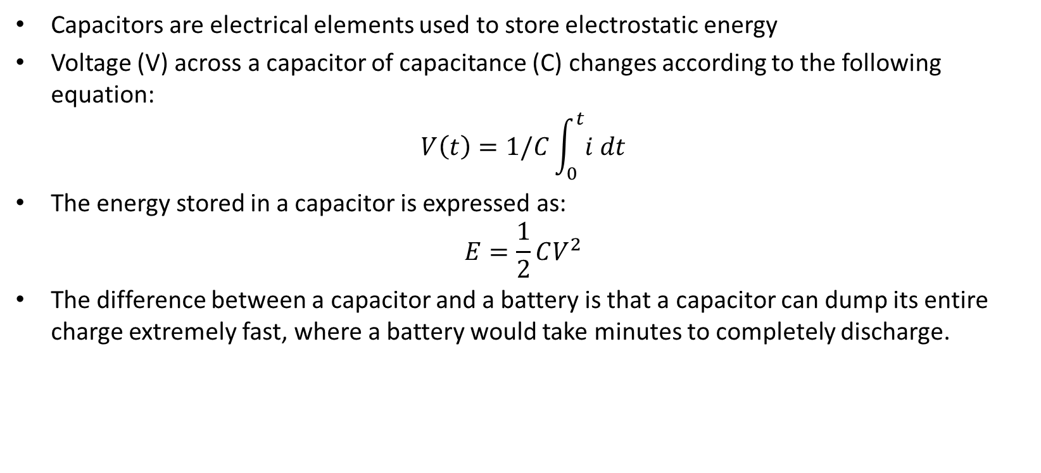
ELECTRICAL SYSTEM MODELING: CAPACITORS
Capacitors are electrical elements used to store electrostatic energy
Voltage (V) across a capacitor of capacitance (C) changes according to the following equation:
$$V\left(t\right)=1/C\int_{0}^{t}{i dt}$$
The energy stored in a capacitor is expressed as:
$$E=\frac{1}{2}CV^{2}$$
The difference between a capacitor and a battery is that a capacitor can dump its entire charge extremely fast, where a battery would take minutes to completely discharge.

Slide 6
ELECTRICAL SYSTEM MODELING: CAPACITORS
Capacitors are used in several different ways in electronic circuits:
Capacitors are used to store charge for high-speed use (camera flash).
Capacitors eliminate ripples by evening out the voltage by absorbing peaks/filling in valleys.
A capacitor blocks DC voltage. Example: connect a capacitor to a battery and no current will flow between the poles of the battery once the capacitor charges.
Alternating current (AC) signal can flow through a capacitor, that's because capacitor will charge/discharge as the alternating current fluctuates, making it appear that the alternating current is flowing.

Slide 7
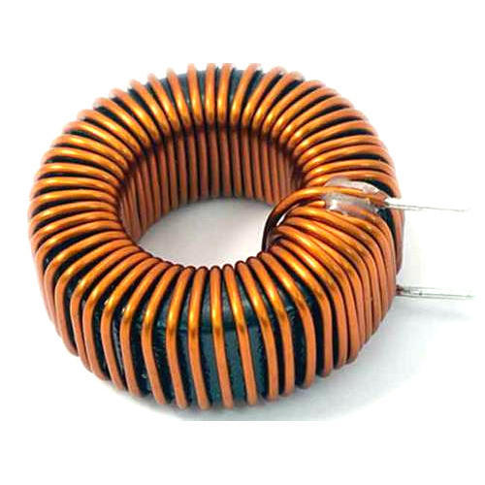
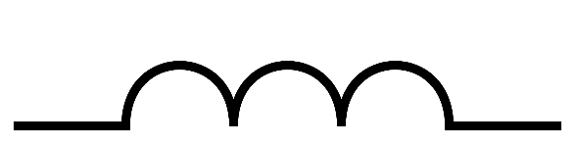
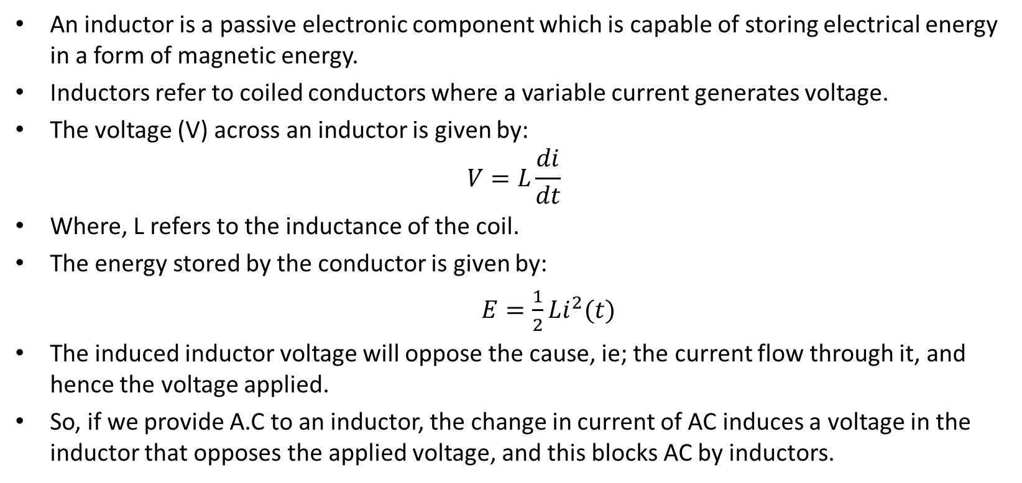
ELECTRICAL SYSTEM MODELING: INDUCTORS
An inductor is a passive electronic component which is capable of storing electrical energy in a form of magnetic energy.
Inductors refer to coiled conductors where a variable current generates voltage.
The voltage (V) across an inductor is given by: $V=L\frac{di}{dt}$
Where, L refers to the inductance of the coil.
The energy stored by the conductor is given by:
$E=\frac{1}{2}Li^{2}(t)$
The induced inductor voltage will oppose the cause, ie; the current flow through it, and hence the voltage applied.
So, if we provide A.C to an inductor, the change in current of AC induces a voltage in the inductor that opposes the applied voltage, and this blocks AC by inductors.

Slide 8
ELECTRICAL SYSTEM MODELING: NOTES
Resistors consume both AC and DC, while the inductor will block AC and allow only DC to pass through, and the capacitor will block DC and only allow AC to pass through.
A reactance is simply the resistance that an inductor would offer to AC, or the resistance that a capacitor would offer to DC.
The resistance of a resistor does not depend on the frequency of the AC, while the reactance of an inductor or capacitor depends on the frequency of the AC.

Slide 9
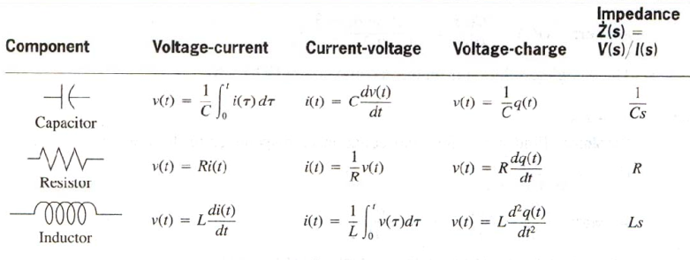
ELECTRICAL SYSTEM MODELING: SUMMARY

